Slide 1
Boosting Algorithm

Slide 2
AdaBoost Algorithm (Adaptive Boosting)
AdaBoost is an ensemble method like Decision Trees and Random Forests.
It transforms weak learners into a strong learner for the dataset.
Uses decision stumps (one root node with two leaf nodes) as weak learners.
Misclassified samples from one stump are transferred to the next stump.
The next stump assigns more weight to misclassified samples and focuses on them.
This process continues until the samples are classified correctly (or maximum iterations reached).

Slide 3
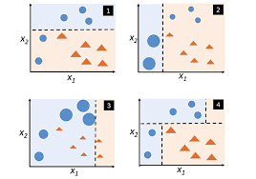

Slide 4
Gradient Boosting
Gradient Boosting is an ensemble method like AdaBoost, Decision Trees, and Random Forests.
It builds decision trees sequentially, where each tree corrects the errors of the previous one.
Starts with an initial prediction (like the mean of target values).
Calculates the residuals (errors) between predicted and actual values.
A new tree is trained on these residuals to minimize the error.

Slide 5
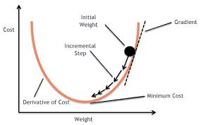
Each tree’s contribution is scaled by a learning rate(Learning Rate is a key hyperparameter that controls how fast a model learns during training. It sets the step size taken to minimize the loss function, determining how much the model’s weights are updated in response to errors.) to prevent overfitting.
The process continues until the error is minimized or the maximum number of trees is reached.
This graph shows how gradient descent updates model weights step by step, using the slope (gradient) of the cost curve, until it finds the minimum error.

Slide 6
XGBoost (Extreme Gradient Boosting)
XGBoost is an optimized version of Gradient Boosting with additional features for speed, accuracy, and regularization.
XGBoost is optimized for speed and can efficiently handle large datasets, even in distributed computing environments. It utilizes parallel processing to accelerate training times.
XGBoost incorporates L1 and L2 regularization techniques (Lasso and Ridge) to prevent overfitting and improve the generalization capability of the models.
XGBoost has a built-in mechanism to handle missing data automatically, eliminating the need for explicit imputation in many cases.

Slide 7
LightGBM
LightGBM is a gradient boosting framework developed by Microsoft, optimized for speed and efficiency, especially with large datasets.
Unlike XGBoost’s level-wise tree growth, LightGBM uses a leaf-wise growth strategy, always splitting the leaf with the maximum loss reduction.
It applies a histogram-based binning technique, where continuous features are grouped into discrete bins, reducing memory usage and speeding up training.
LightGBM is typically faster than XGBoost, especially when working with very large datasets containing millions of rows and high-dimensional features.
It supports parallel and GPU learning, making it scalable to big data applications.

Slide 8
